Slide 1
Pointer and Array Review Session 01
Course : Data Structures
Effective Period : December 2018

Slide 2
Learning Outcomes
At the end of this session, students will be able to:
LO 1: Explain the concept of data structures and its usage in Computer Science

Slide 3
Outline
Pointer Review
Array
Storing Array Values
Accessing Array

Slide 4
Pointer

Slide 5
Pointer
Every variable in C has a name and a value associated with it, and when a variable is declared, a specific block of memory within the computer is allocated to hold the value (the size depends of the data type).
For example:
int x = 10;
The size of integer may vary from one system to another.
In 32 bit systems, an integer variable is allocated 4 bytes while in 16 bit systems, it is allocated 2 bytes

Slide 6

Pointer
When the statement executes, the compiler sets aside 2 bytes of memory to hold the value 10 and it also sets up a symbol table in which it adds the symbol x and the relative address in the memory where those 2 bytes were set aside.
Thus, every variable in C has a value and also a memory location (address)

Slide 7
Pointer
Pointer is a data type whose value refers to another value stored elsewhere in computer memory using its address.
The two most important operators used with pointer type are:
& the address operator
* the dereferencing operator

Slide 8
Pointer
Pointers are frequently used in C, as they have a number of useful applications. Such as:
Used to pass information back and forth between a function and its reference point.
Enable the programmers to return multiple data items from a function via function arguments or to pass arrays and strings as function arguments
Provide an alternate way to access the individual elements of an array
Used to create complex data structures, such as trees, linked list, linked stack, linked queue and graphs
Used for the dynamic memory allocation of a variable

Slide 9
Pointer
To declaring pointer variables can be given as below:
data_type *ptr_name;
For example:
int *pnum;
char *pch;
float *pfnum;
In each of the above statements, a pointer variable is declared to point to a variable of the specified data type.
Although all these pointers point to different data types, they will occupy the same amount of space in the memory (depends on the platform where the code is going to run).

Slide 10
Pointer
If we have the declaration: int x;
int *px;
then x is an integer and px is a pointer to an integer.
If we say:
px = &x;
then &x returns the address of x and assigns it as the value of px.
To assign a value of x we can say:
x = 10; or *pi = 10;

Slide 11
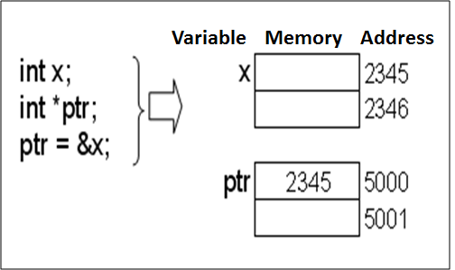
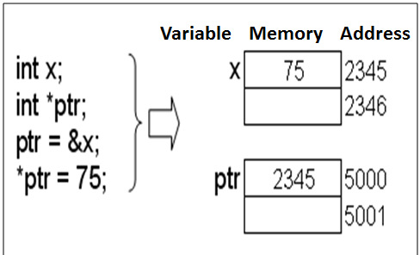
Pointer Concept

Slide 12
Pointer
What is the output of this program?
int a = 10;
int *p = &a;
printf( “%d\n”, *p );
a = 17;
*p = 20;
printf( “%d\n”, a );

Slide 13
Array

Slide 14
Linear List
A linear list is an elementary abstract data type that allows storage of elements of the same data type in the same contiguous memory area.
Most of programming languages support the implementation of a linear list as an array.

Slide 15
Array
A collection of similar data elements
These data elements have the same data type (homogenous)
The elements of the array are stored in consecutive memory locations and are referenced by an index
Array index starts from zero

Slide 16
Array Declaration & Accessing Array
One Dimensional Array
Declaration:
int arr[5];
Accessing:
arr[0] = 7;
arr[1] = 2;
arr[2] = 13;
arr[3] = 13;
arr[4] = 13;
Syntax:
type name[size];
An array of size N have indexes from 0 to N-1.

Slide 17
Array Declaration & Accessing Array
Two Dimensional Array
Declaration:
int arr[3][6];
Accessing:
arr[0][2] = 2;
arr[2][1] = 9;
arr[1][5] = 13;
arr[2][4] = 10;
Syntax:
type name[size1][size2];
The first index of array ranged from 0 to size1 – 1.
The second index of array ranged from 0 to size2 – 1.

Slide 18
Array Declaration & Accessing Array
Multi Dimensional Array
Declaration:
int arr[4][3][7][10];
Accessing:
arr[0][2][2][9]= 2;
arr[2][1][6][0]= 9;
arr[3][0][0][6]= 13;
arr[2][1][3][8]= 10;
Syntax:
type name[size1][size2];
The first index of array ranged from 0 to size1 – 1.
The second index of array ranged from 0 to size2 – 1.

Slide 19
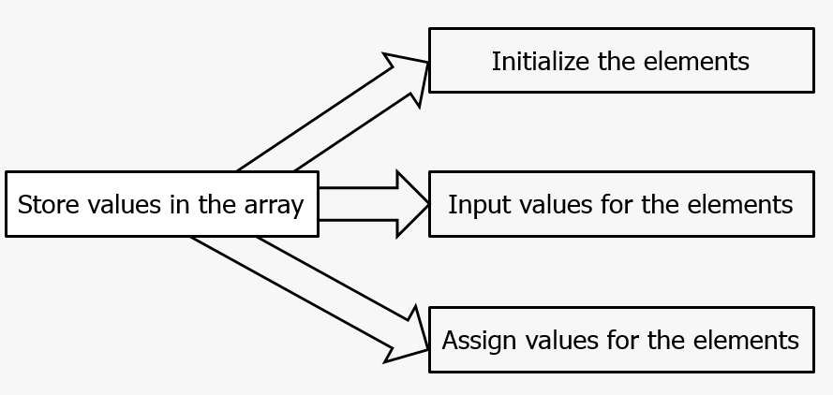
Storing Array Values

Slide 20
Storing Array Values
Initialization of Arrays
Example: int marks[5] = {90, 82, 78, 95, 88};
Inputting Values
Example: int i, marks[10];
for (i=0; i<10; i++)
scanf(“%d”, &marks[i]);
Assigning Values
Example: int i, arr1[10], arr2[10];
for(i=0; i<10; i++)
arr2[i] = arr1[i];

Slide 21
Operations in Array
There are a number of operations that can be performed on arrays. They are:
Traversal
Insertion
Searching
Deletion
Merging
Sorting

Slide 22
Summary
Pointer is a data type whose value refers to another value stored elsewhere in computer memory using its address
Array is a collection of similar data elements
Array index starts from zero

Slide 23
References
S. Sridhar. 2015. Design and Analysis of Algorithms. Oxford University Press. New Delhi. ISBN: 9780198093695. Chapter 5
Reema Thareja. 2014. Data structures using C. Oxford University Press. New Delhi. ISBN:9780198099307. Chapter 1 & 3
Arrays in C/C++ Programming, http://www.mycplus.com/tutorials/data-structures/arrays-c-cpp-programming

